Slide 1



Consumer Goods Ad-Hoc Insights

Slide 2

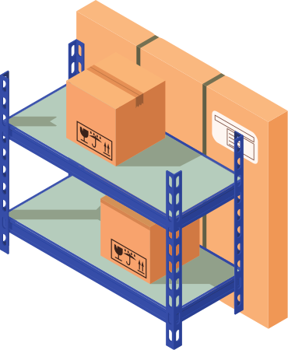
Introduction
Atliq Hardware, a fictional corporation, stands out as a major computer hardware manufacturer in India and has a robust global presence.
Despite its prominence, the management recognizes a need for more timely and informed decisions backed by data insights.

Slide 3
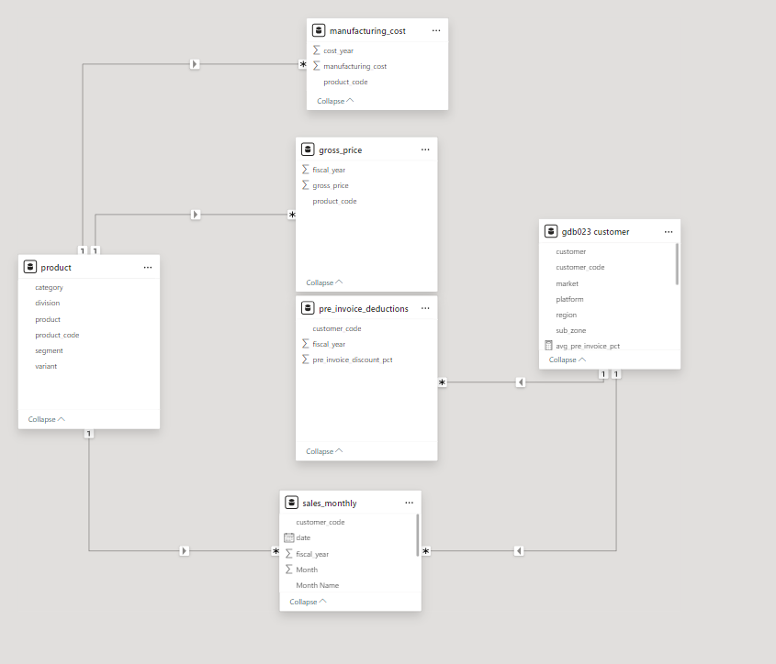
Dataset

Slide 4
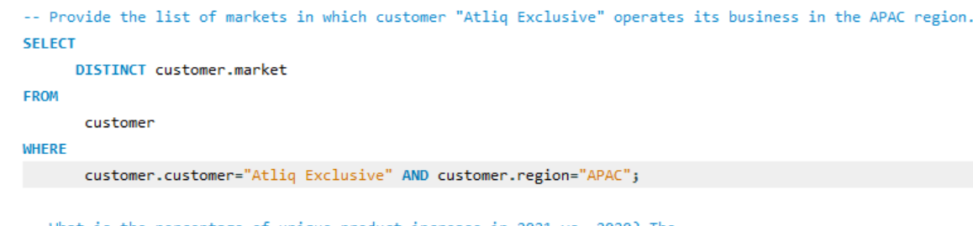
Provide the list of markets in which customer "Atliq Exclusive" operates its
business in the APAC regio

Slide 5
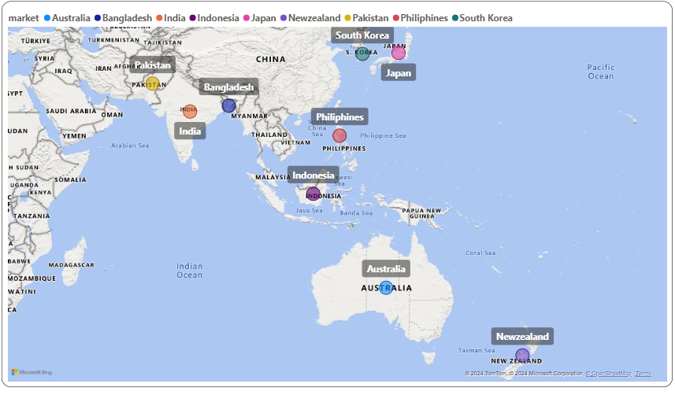
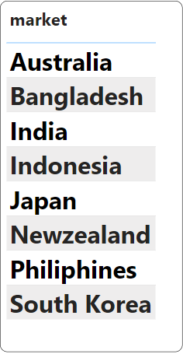
The Atliq Exclusive customer has established in eight key market in the region APAC

Slide 6
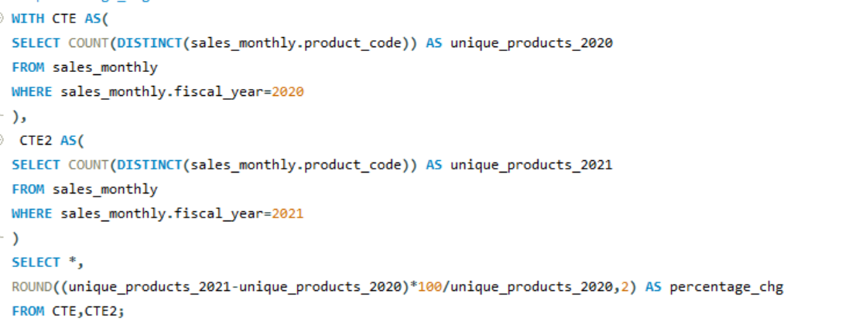
What is the percentage of unique product increase in 2021 vs. 2020? The

Slide 7
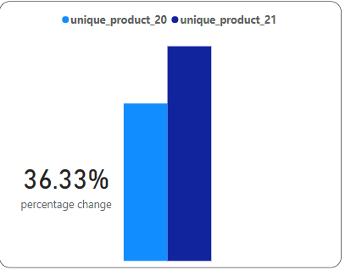

In the year 2020 there are total 245 products and in the year 2021 we have total 334 products from the last year the count of products has increased which around 36%

Slide 8
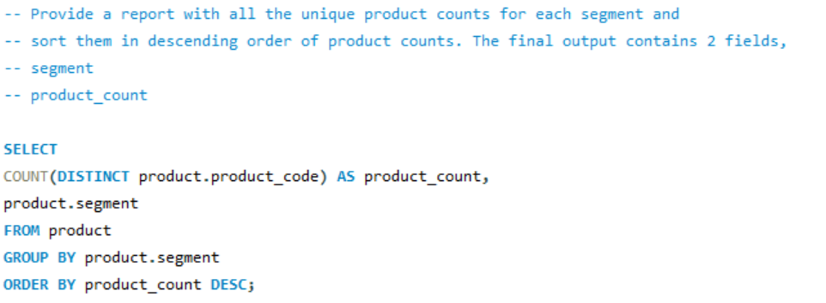
Provide a report with all the unique product counts for each segment and
sort them in descending order of product counts.

Slide 9
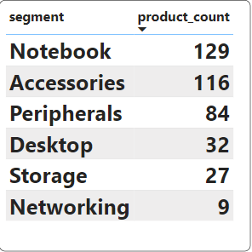
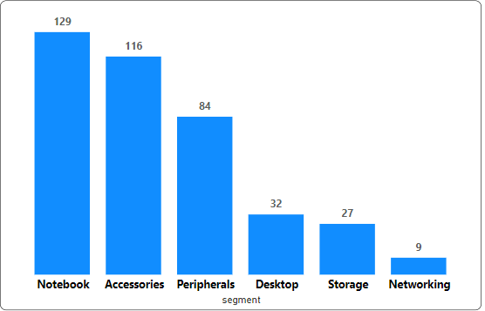
Atliq Hardware produce more number of products across notebooks,accessories and peripherals segements
There are less number of products across the Desktop, Storage and networking segments

Slide 10
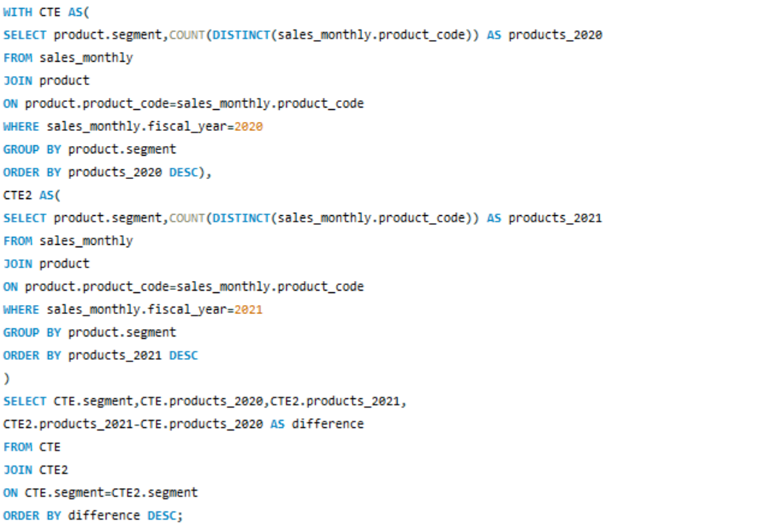
Follow-up: Which segment had the most increase in unique products in
2021 vs 2020?

Slide 11
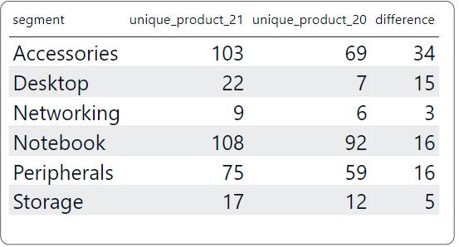
In 2021,the Atliq Hardware mainly focused on Accessories segment which increases its products with new 34 products.

Slide 12
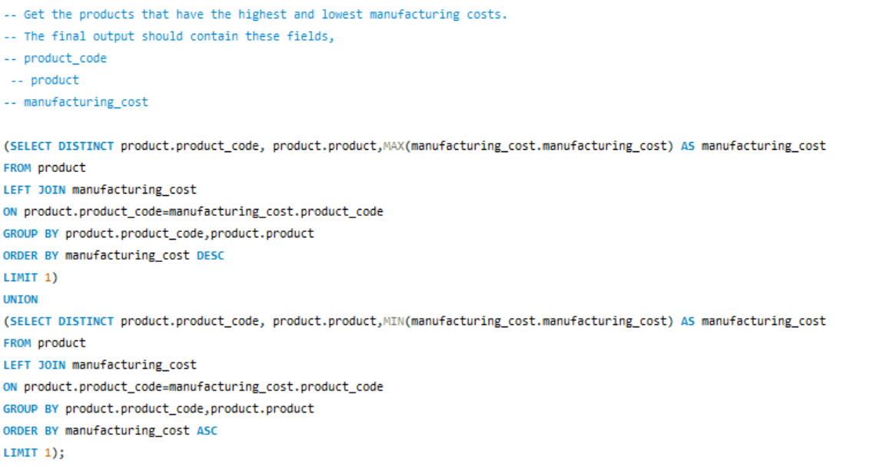
Get the products that have the highest and lowest manufacturing costs.

Slide 13
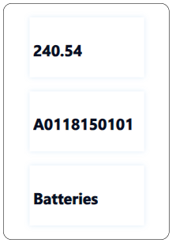
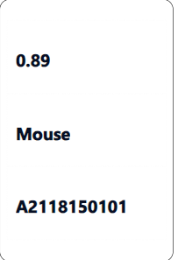

Highest Manufacturing Cost
Lowest Manufacturing Cost

Slide 14
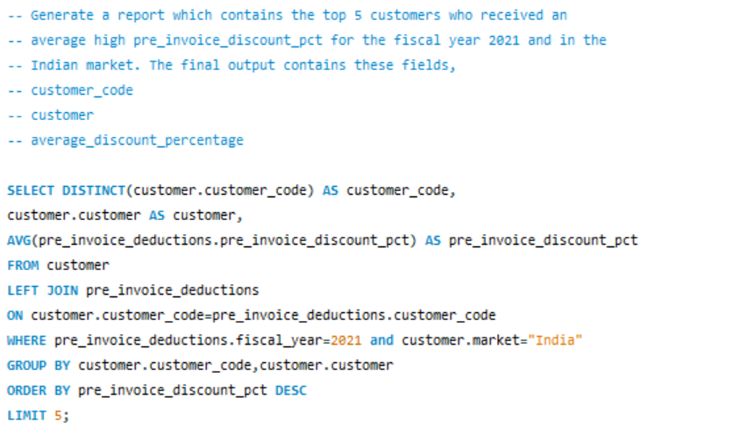
Generate a report which contains the top 5 customers who received an
average high pre_invoice_discount_pct for the fiscal year 2021 and in the
Indian market.

Slide 15
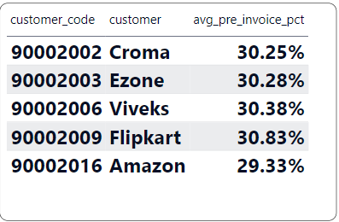
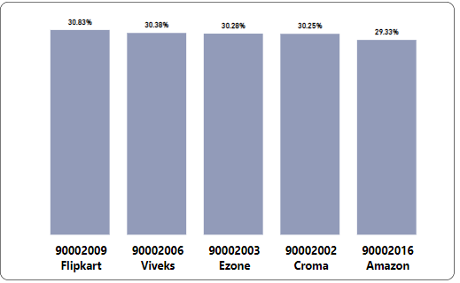
The Flipkart Customer holds the most heavily discount in the Indian Market with a pre_invoice_discount around 31% and the Atliq hardware provides similar discount across its top customers in 2021.

Slide 16
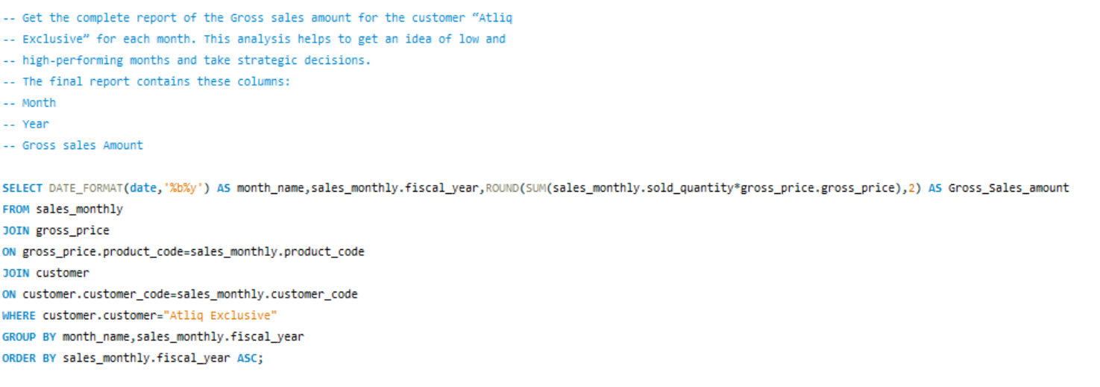
Get the complete report of the Gross sales amount for the customer “Atliq
Exclusive” for each month. This analysis helps to get an idea of low and
high-performing months and take strategic decisions.

Slide 17
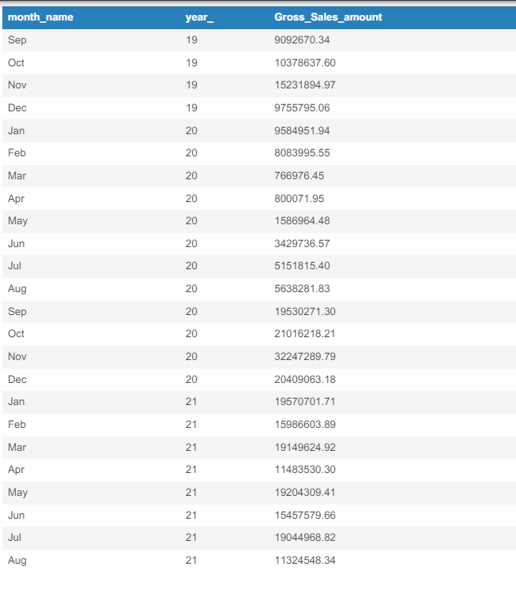
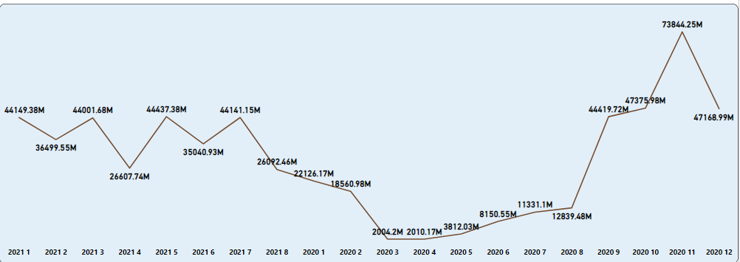
In the year 2020 the month November has become the highest sales for the Atliq Exclusive whereas the month March has recorder lowest sales across all months
In the year 2020 we can see that the sales has been declined between March to August . This decline should be the impact of COVID-19.However the sales has increased consistently after the pandemic

Slide 18
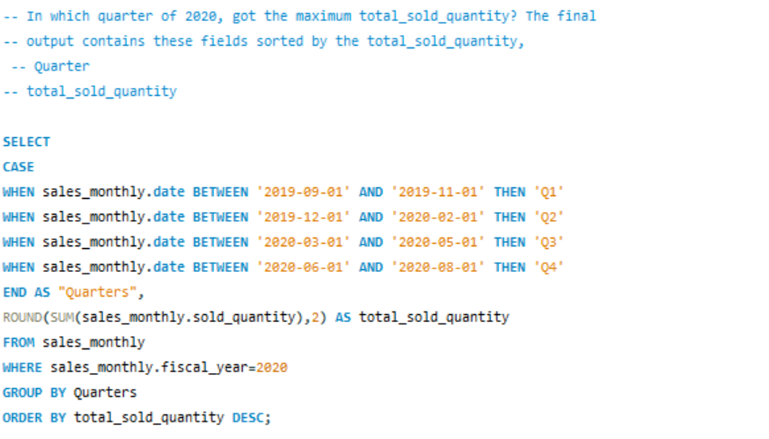
In which quarter of 2020, got the maximum total_sold_quantity? The final
output contains these fields sorted by the total_sold_quantity,

Slide 19
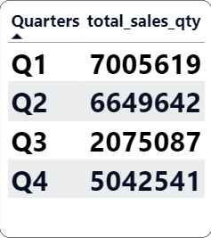
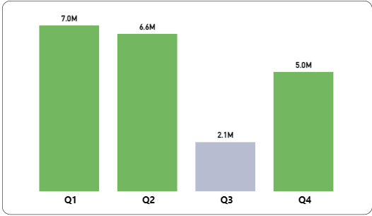
In the third quarter from (march,april,may) from the peak of COVID-19 and widespread lockdown the sales has been decreased

Slide 20
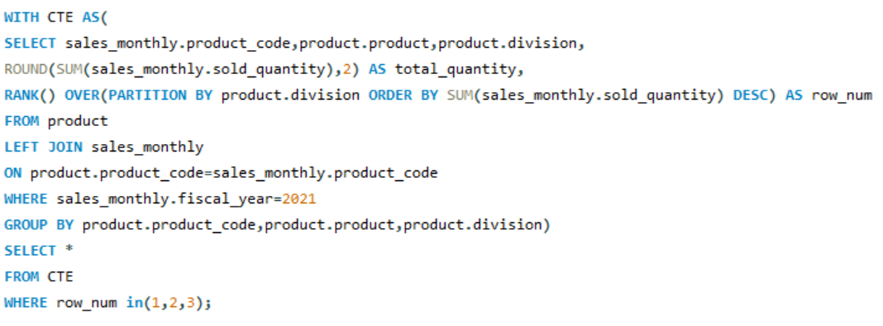
Get the Top 3 products in each division that have a high-- total_sold_quantity in the fiscal_year 2021?

Slide 21
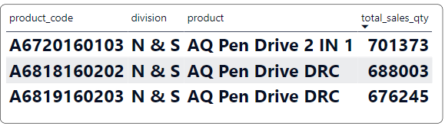
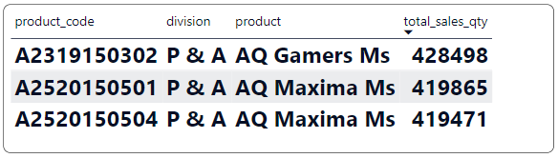
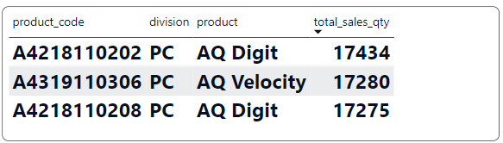
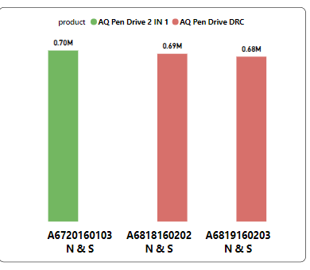
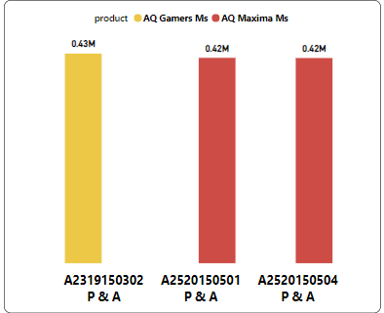
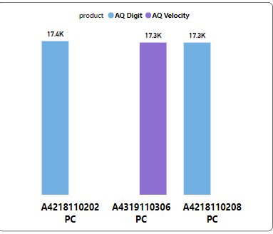
PCyyyyyy
N & S
P & A
PC

Slide 22
INSIGHTS
In the fiscal year 2021 our unique product has experienced a good growth around 36.33% of increase in sales compared to previous year
The Top selling product in the hardware is Notebook while the lowest selling product is the Networking
Among the product manufacturing cost the batteries has the highest expenditure and mouse has the lowest expenditure
During FY 2021 the Flipkart made the highest invoice discount which around 30.83% and Amazon has the lowest invoice discount around 29.3%
In the year 2020 the lowest sales period was occurred in the the month of march and achieved around 2.8million and in november2021 we achieved a more number of sales which around 32.2 million

Slide 23
THANK YOU

